Slide 2

UNIT 6: MONEY
LISTENING
HONESTY PAYS

Slide 3
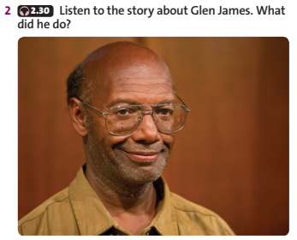



Slide 4
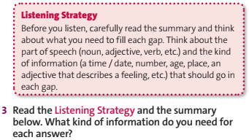


Slide 5

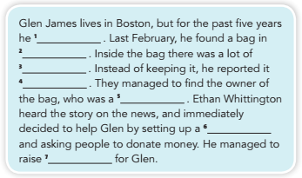


Slide 6
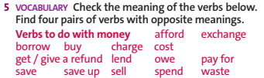


Slide 7



Slide 8
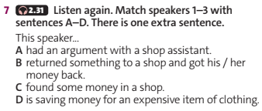


Slide 9
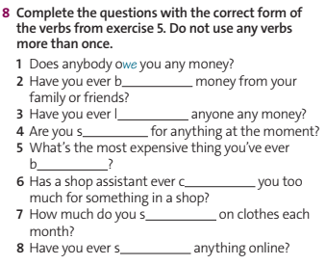


Slide 10
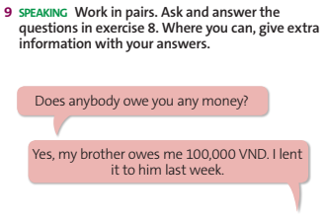

Slide 11

1/ Learn by heart all new vocabulary, phrases, and structures.
2/ Prepare for the next lesson.

Slide 12
THANK YOU
FOR YOUR ATTENTION

